Slide 1
New College Durham: Understanding children's behaviours
Sarah Martin-Denham (sarah.denham@sunderland.ac.uk)
November 2021

Slide 2
Think about...
“Additional Needs and Challenging Behaviours”
What are the potential causes and implications of adversity for children and families?
What are the implications of not determining reasons for behaviours?

Slide 3
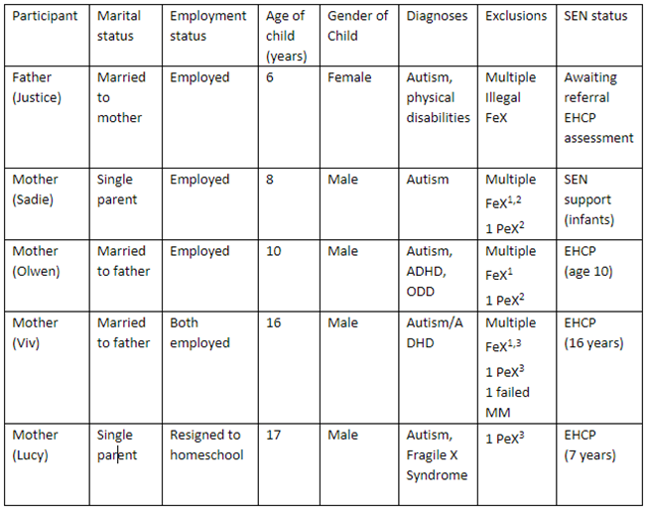
Martin-Denham, S. (2022a) Autism and school exclusion: Caregiver’s reflections. [Accepted: Support for Learning].
Of the forty-one caregivers who took part in the original study (Martin-Denham, 2020a; 2020b; 2020c), five met the criteria for this article:
They had a child with a diagnosis of autism
They had a child who had received fixed-period and/or permanent exclusions

Slide 4
Objectives: To determine the barriers and enablers to mainstream schooling for children with autism and to explore the emotional effect of the journey to school exclusion on the child and caregivers.
Background: research has highlighted that some mainstream schools do not listen to caregivers concerns about their child’s development, behaviours and mental health (Martin-Denham and Watts, 2019; Martin-Denham, 2020a; 2020b; 2020c; 2020d; 2021a;2022a;2022b)
Methods: interpretative phenomenological analysis was employed to understand how participants made sense of their lived experiences, revealing four superordinate themes: inadequate special educational needs and disability (SEND) support, psychological impact, health-imposed barriers to diagnoses, and effective support.

Slide 5
Inadequate SEND support | Psychological impact | Health imposed barriers to diagnoses | Effective support
'They didn't put any support in place; they didn't put any time-out breaks in place, no sensory support in place. So, he was dumped into a classroom with 30-odd, it went downhill drastically' (Sadie). | 'He was saying things like “I want to live in heaven where I can be away from all the nastiness in school.” He was in pieces, it was dreadful' (Sadie). | 'You can't get into CYPS unless referred from CAMHS. You don't just get that it's not automatic because they kept saying, “he's too young” (Olwen). | 'They were fantastic. I had a good relationship with his teacher. We spoke quite regularly because I picked him up from school… His teacher was also the SEND coordinator, so that was helpful and we just had an eye on it' (Sadie). Reflecting on the infant school.
'If you're going to lock him up in a room, well, he'll just be like a crazed animal' (Olwen). | 'He was saying things like he didn't want to be here. He didn't fit in. Nobody liked him; he had no friends' (Viv). | 'When he was three and a half we were told there were no concerns' (Viv).
'They were trying to push for her to only to attend for half a day, because of a lack of lunchtime facilities to support her to eat' (Justice). | 'You can see the anxiety, when your son says he wants to die that is hard to listen to' (Olwen). | 'You need experts to diagnose children quicker. We had to pressure them; if she had been diagnosed earlier then she would have got that support, she could have gone to a specialist school' (Justice). | 'This school [alternative provision] takes children more as an individual. Because all the children in here all have different issues (Viv).'

Slide 6
Justice
1 | Support from multiple health consultants for physical disabilities | 12 | Caregiver offers to home school child, mother working with LA to find a school place
2 | GP refers child to SaLT | 13 | Child added to waiting list for autism specific school provision
3 | Caregivers share developmental concerns with school | 14 | Caregivers request funding support for 1:1 tuition
4 | Mother carries out independent research into how to support daughter | 15 | School rejects request - insufficient funds
5 | Mother volunteers at special school to learn more | 16 | School provides TA support as an alternative
6 | School takes decision to retain child in reception for a second year | 17 | School suggests half day attendance, parents decline
7 | LA educational psychologist assessment, recommends transferral to a specialist unit | 18 | School imposes illegal fixed-period exclusions
8 | Caregivers decline specialist placement, feels the school does not want child | 19 | Mother buys more educational toys to support development at home
9 | Paediatrician diagnoses autism spectrum disorder, recommends mainstream with support | 20 | Caregivers share concern with school that child is regressing
10 | School recommends alternative school, caregivers refuse, school not for children with autism | 21 | Caregivers request dual placement for child
11 | School pressure parents to take place citing concerns over upcoming Ofsted inspection

Slide 7
Lucy
1 | School report behaviour concerns to mother | 13 | Child moved to back of class
2 | Child diagnosed with autism spectrum disorder | 14 | Multiple fixed-period exclusions
3 | Referred to CAMHS, CAMHS refer to CYPS | 15 | Mother requested school seek external support
4 | CAMHS refer to CYPS | 16 | School decline request
5 | CYPS reject referral | 17 | Mother contacts Autism Outreach
6 | Mother request transition meeting with School 2 (juniors) | 18 | Mother feels school does not want child
7 | Junior school reject request for transition meetings | 19 | Pupil assaults another child
8 | School change child's class the day before term starts | 20 | Permanent exclusion
9 | Child starts school 2 | 21 | Mother home schooling, considers tribunal case
10 | No SEN school support in place | 22 | Child starts school 3
11 | First fixed-period exclusion | 23 | Child participating and learning
12 | School tell parent child is difficult to manage

Slide 8
Olwen
1 | Accessed CAMHS who referred to CYPS who referred back to CAMHS | 16 | Multiple fixed-period exclusions
2 | Teacher reports being hit by child | 17 | Caregivers withdraw child from School 1
3 | Multiple fixed-period exclusions | 18 | Child diagnosed with ASD, ADHD and ODD
4 | Caregivers request referral for EHCP assessment by school | 19 | Multiple fixed-period exclusions
5 | School refuse EHCP assessment request | 20 | Parent returns to GP multiple times due to school exclusions
6 | School unable to needs, segregates child at breaktimes, parents complain | 21 | GP Referral to CAMHS
7 | Mother becomes anxious school will ring about child's behaviour | 22 | CAMHS refer to CYPS
8 | School attributes behaviour to home life and parenting | 23 | Caregivers feels school does not want child
9 | Early Help carry out home visit | 24 | Child school refuser, caregivers withdraws child from school
10 | Early Help unable to support | 25 | Child starts school 3
11 | School describe child as 'naughty' won't allow sensory breaks | 26 | Mother seeks external agency support which secures LA involvement
12 | Mother told to attend parenting course by school | 27 | Local Authority provide a PRU place
13 | Child Starts school 2 | 28 | CYPS give mental health support to child, external agency support parent
14 | CAMHS access resumed | 29 | Child formally withdrawn from mainstream schooling to attend a PRU
15 | CAMHS discharge - no issues | 30 | EHC Plan secured

Slide 9
Viv
1 | Parent requests SaLT referral | 13 | Child discloses suicidal feelings to caregivers | 25 | Child placed on school report | 37 | School declines EHCP Assessment request
2 | SaLT Finds no concerns | 14 | Caregivers tell child about ASD diagnosis | 26 | Multiple fixed-period exclusions | 38 | School move
3 | School reports disruptive behaviour to parent | 15 | Child assaults a pupil in school | 27 | Child physically assaulted by another child, resulting in dislocated finger | 39 | Child bullied for being different
4 | Parent requests consultant referral, consultant, no concerns | 16 | First fixed-period exclusion | 28 | Mother reports incident to school, dismissed as accident | 40 | Mother requested managed move, managed move agreed to PRU
5 | Consultant discharges with no concerns | 17 | School refers child to CAHMS | 29 | Caregivers contact police about disability discrimination | 41 | School move to PRU
6 | Mother arranges referral to consultant, child diagnosed with ASD | 18 | Multiple fixed-period exclusions | 30 | Police interviews result in no further action | 42 | Bespoke curriculum implemented, vocational college training agreed
7 | Caregivers request assessment for an EHCP | 19 | Multiple fixed-period exclusions | 31 | Mother requested a managed move/EHCP assessment by school | 43 | Child passing exams
8 | School decline caregiver request for EHCP | 20 | CAMHS suspect ADHD and refer to CYPS | 32 | School declines Managed Move and EHCP needs assessment | 44 | School 3 submits EHC assessment request
9 | Educational psychologist assessment arranged by school | 21 | Mutiple fixed-period exclusions | 33 | Mother prescribed beta blockers for anxiety | 45 | EHCP needs assessment rejected
10 | Educational psychologist finds no learning difficulties | 22 | CYPS diagnose ADHD, child medicated for ADHD | 34 | Child assaults pupil | 46 | EHCP assessment refusal appealed, school 3 provide supporting evidence
11 | SENCO requests assessment for EHCP | 23 | Caregivers report bullying to school | 35 | Permanent school exclusion | 47 | EHCP assessment decision overturned, EHCP granted
12 | LA decline assessment for EHCP | 24 | School removes breaktimes but re-instates after parental complaint | 36 | Caregivers re-request referral for EHCP assessment by school

Slide 10
Findings
The CAFA (2014) created a statutory duty for the involvement of caregivers in decisions that affect their children. Supporting caregivers via early identification, high quality provision, decision-making, choice and control, and agency collaboration are explicit in the (DfE and DoH, 2015) code. However, the findings from this study suggest that the caregivers met barriers to gaining prompt assessment and identification of SEND across education and health.
The onus fell on the caregivers to advocate for effective support from schools. A lack of prompt diagnoses and effective school support is detrimental to the emotional and physical health of both children and caregivers.
Training is needed to ensure thresholds for education, health and care needs assessments are understood, alongside evidence-based approaches to support children with SEND.

Slide 11
Martin-Denham, S. (2021f) 'School exclusion, substance misuse and use of weapons: An interpretative phenomenological analysis of interviews with children', Support for Learning, 36(4). doi:10.1111/1467-9604.12379.

Slide 12
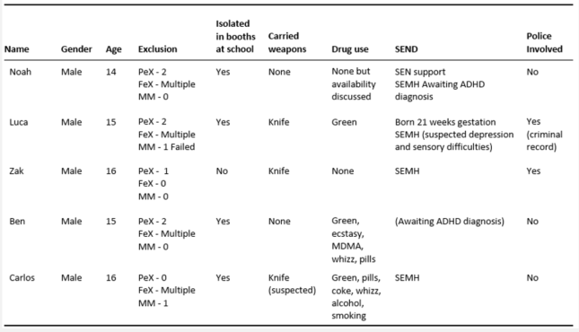
Theographs
Five children
• Drivers, supply and implications of drug use
• Drivers and implications of carrying a knife
• Solutions to reducing fixed-period and permanent exclusion

Slide 13
Year | Overview
Y7 | Death of aunt, grief, anger, unable to cope with shouting
Y7 | Change of leadership, zero tolerance, isolation (bridge)
Y9 | Knife to make bong PeX, drug curiosity
Y10 | School 2, transition from AP too many points, failed
Y10 | School 3, 10 points only allowed 6, failed. Banter over a girl and phone in class
Y10-11 | Drug awareness, AP, engaging
'In my year there has been 6 people permanently excluded. They all got excluded when they started taking drugs. Their behaviour changed'

Slide 14
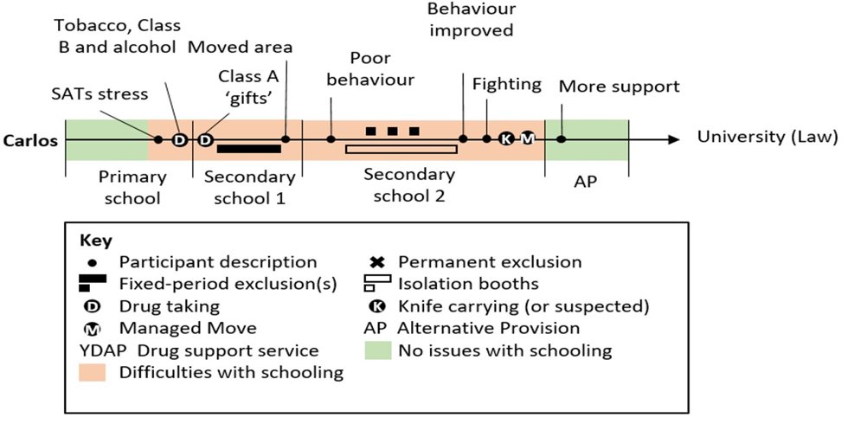
Year​ | Overview​
Y6 | SATS stress, academic focus​, smoking, weed, alcohol, drugs because older kids take them (Y10s-11s)
Y7 ​ | Unable to cope with teachers shouting, isolation, not taught
Y8-Y10 | Frequent isolation, no learning
Y10 | Accused of having a knife (never found)
Y10​ | School 3, 10 points only allowed 6, failed. Banter over a girl and phone in class​
Y10-11​ | Drug awareness, AP, engaging​
‘Younger people would get involved because the older people were taking it. The younger people would start hanging around with them and then they would take it. That happened to me. I was in Year 7 and I was messing up. So, I was ‘cool’, so I started hanging around with Year 10s and 11s. That was how I got into it and that is how most people get into it’.

Slide 15
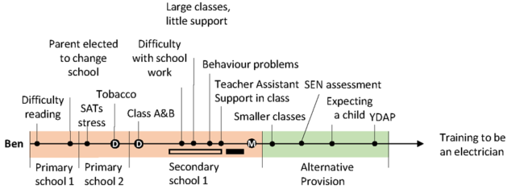
Year​ | Overview​
Y-5-6 | Taken out of class, unable to read, SATS stress
Y7- 11 | Unable to access curriculum, unidentified SEN
Y7-10 | Frequently in isolation
Y9 | Support for behaviour
Y11 | Becoming a father, came of drugs, focused on exam success, engaging in AP
I got took out class to do my work. Because I couldn’t read (y6).
They got this lass in to help with my behaviour. Why give me that in Year 9? Or Year 8? When I needed it in Year 7.

Slide 16
Drivers for drug use
Children are consuming drugs mainly to aid concentration in school, to self-medicate to reduce sanctions imposed on them by teachers and to relax
School curriculum pressures, too much focus on attainment at the cost of mental health
Lack of both early and prompt identification and support for children with SEND/SEMH from schools and complex referral processes
Further research needed on school exclusion and drug use

Slide 17
Access at sure.sunderland.ac.uk - Search Martin-Denham
Martin-Denham, S. (2015) Teaching Children and Young People with Special Educational Needs and Disabilities 0-25 years. London: SAGE Publications, Ltd.
Martin-Denham, S., Saddler, H. and Donoghue, J. (2017) The prevalence of Special Educational Needs and Disabilities (SEND) identified in young people, aged 3-16, across the City of Sunderland: School of Education. Sunderland: University of Sunderland.
Martin-Denham, S. and Watts, S. (2019) SENCO Handbook: Leading Provision and Practice. London: SAGE Publications, Ltd.
Martin-Denham, S. and Donaghue, J. (2020a) What is the prevalence of primary and secondary types of Special Educational Needs (SEN) in the City of Sunderland? A national comparative analysis of school census data. Sunderland: University of Sunderland.
Martin-Denham, S. and Donaghue, J. (2020b) A review of school census data on fixed-term and permanent school exclusions in the City of Sunderland. Sunderland: University of Sunderland.
Martin-Denham, S. (2020a) The enablers and barriers to mainstream schooling: The voices of children excluded from school, their caregivers, and professionals. Sunderland: University of Sunderland.
Martin-Denham. S. (2020b) The enablers and barriers to successful managed moves: The voice of children, caregivers, and professionals. Sunderland: University of Sunderland.
Martin-Denham, S. (2020c) A review of school exclusion on the mental health, well-being of children and young people in the City of Sunderland. Sunderland: University of Sunderland.
Martin-Denham, S. and Donaghue, J. (2020c) Excluded for no real reason: What is the extent of the use of the category ‘other’ in school census returns in England? A Policy Brief. Sunderland: University of Sunderland.
Martin-Denham, S. and Donaghue, J. (2020d) Out of sight, out of mind? Managed moves in England. Sunderland: University of Sunderland.
Martin-Denham, S. and Donaghue, J. (2020e) 'The impact and measure of adverse childhood experiences: reflections of undergraduates and graduates in England ACEs', Journal of Public Health (Berl), pp. 1-12. doi:10.1007/s10389-020-01359-z.
Martin-Denham, S. (2020d) 'Riding the rollercoaster of school exclusion coupled with drug misuse: the lived experience of caregivers', Emotional and Behavioural Difficulties, 25(3-4), 244-263. 10.1080/13632752.2020.1848985.
Martin-Denham, S. (2021a) Alternative approaches to school exclusion: Perspectives of headteachers in England. Sunderland: University of Sunderland.
Martin-Denham, S. (2021b) The benefits of school exclusion: Research with headteachers in England. Sunderland: University of Sunderland.
Martin-Denham, S. and Scott, N. (2021) A research review of the impact of ‘how to argue better’ and domestic violence advocates. Sunderland: University of Sunderland.
Martin-Denham, S. (2021c) ‘Walking on eggshells’: An interpretative phenomenological analysis of service-users' perspectives of domestic abuse support services. Sunderland: University of Sunderland.
Martin-Denham, S. (2021d) Family Group Conferencing: A local area research evaluation. Sunderland: University of Sunderland.
Martin-Denham, S. (2021e) 'Defining, identifying, and recognising underlying causes of social, emotional, and mental health difficulties: Thematic analysis of interviews with headteachers in England. Emotional and Behavioural Difficulties', pp. 1-19. DOI.org/10.1080/13632752.2021.1930909.
Martin-Denham, S. (2021f) 'School exclusion, substance misuse and use of weapons: An interpretative phenomenological analysis of interviews with children', Support for Learning, 36(4). doi:10.1111/1467-9604.12379.
Martin-Denham, S. (2021g) ,The varying alternatives to school exclusion: Interviews with headteachers in England', Emotional and Behavioural Difficulties [In production]. Doi.org/10.1080/13632752.2021.1983326.
Martin-Denham, S. and Scott, N. (2021) A research review of the impact of ‘how to argue better’ and domestic violence advocates. Sunderland: University of Sunderland.
Martin-Denham, S. and Scott, N. (2021) Caregiver’s perspectives of Children North East: A therapeutic support service for children exposed to domestic abuse. Sunderland: University of Sunderland.
Martin-Denham, S. (2022a) Autism and school exclusion: Caregiver’s reflections. [Accepted: Support for Learning].
Martin-Denham, S. (2022b) Co-producing SMART targets with children and caregivers of children and young people with special educational needs and disabilities. London: Routledge.

